Slide 1
Transforming Dixie Highway

Slide 2
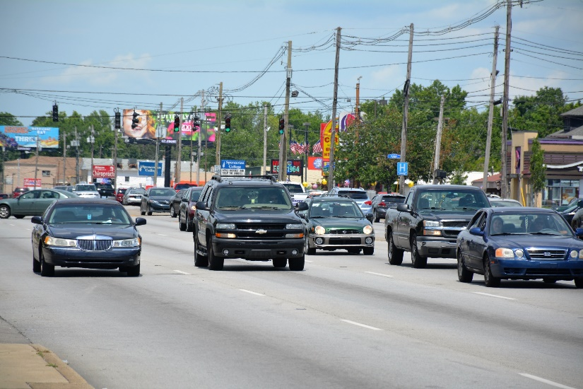
Project History
Southwest Dream Team
Road Safety Audit 20—
2012 Highway Plan “Dixie Do-Over”
Dixie Highway Corridor Master Plan 2013
2015 TIGER Grant Award

Slide 3
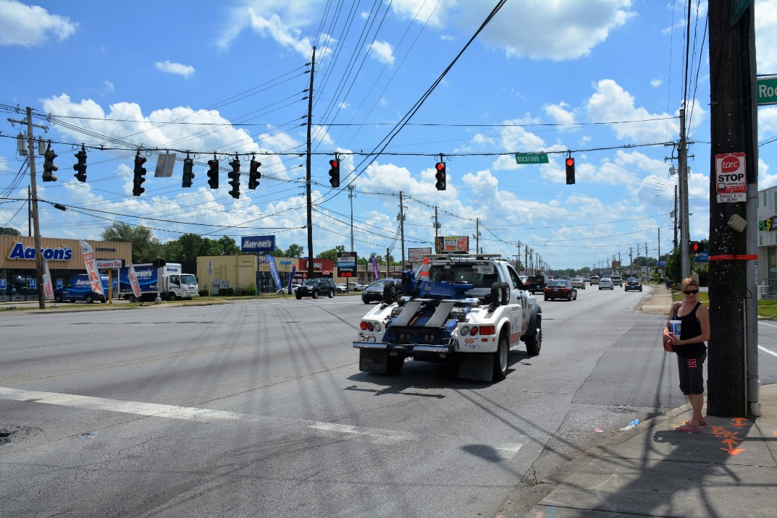
Existing Conditions on Dixie Highway
High fatality, crash rates
Inefficient traffic
$50 million investment
Economic growth

Slide 4
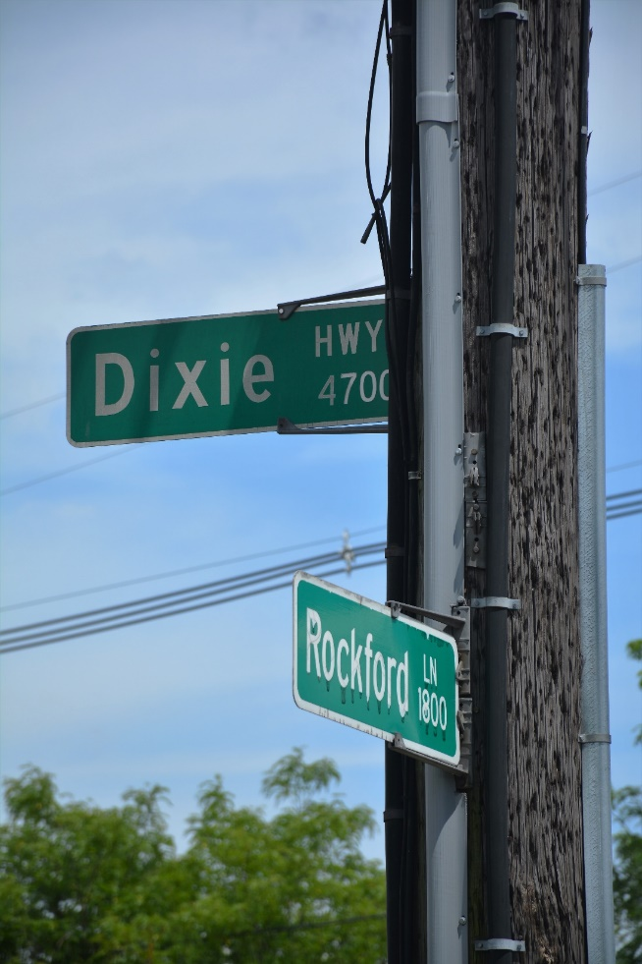
About the Project
Corridor Highway Improvements
Bus Rapid Transit
Intelligent Transportation Systems

Slide 5
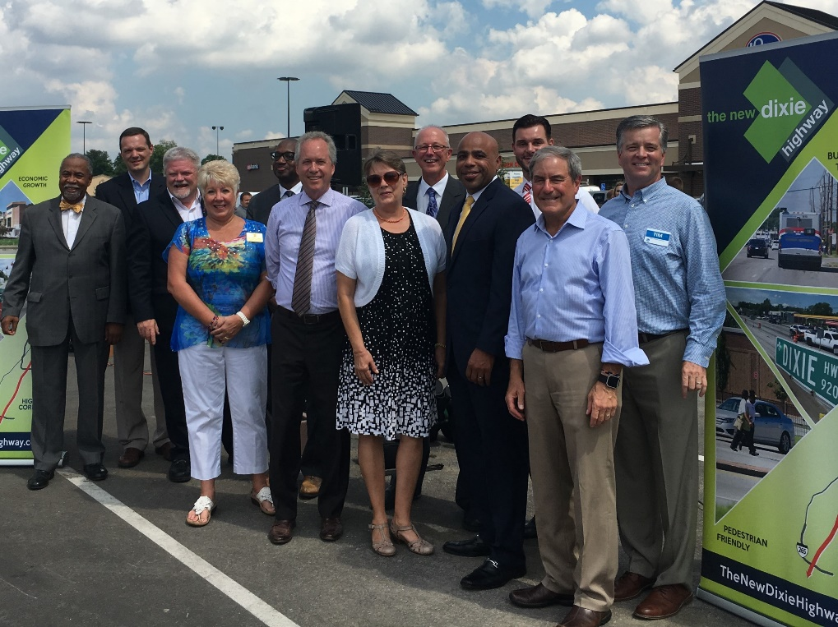
Crucial Partnerships
U.S. Dept. of Transportation
Federal Highway Administration
Kentucky Transportation Cabinet
Louisville Metro Government
Transit Authority of River City
The HDR Team

Slide 6
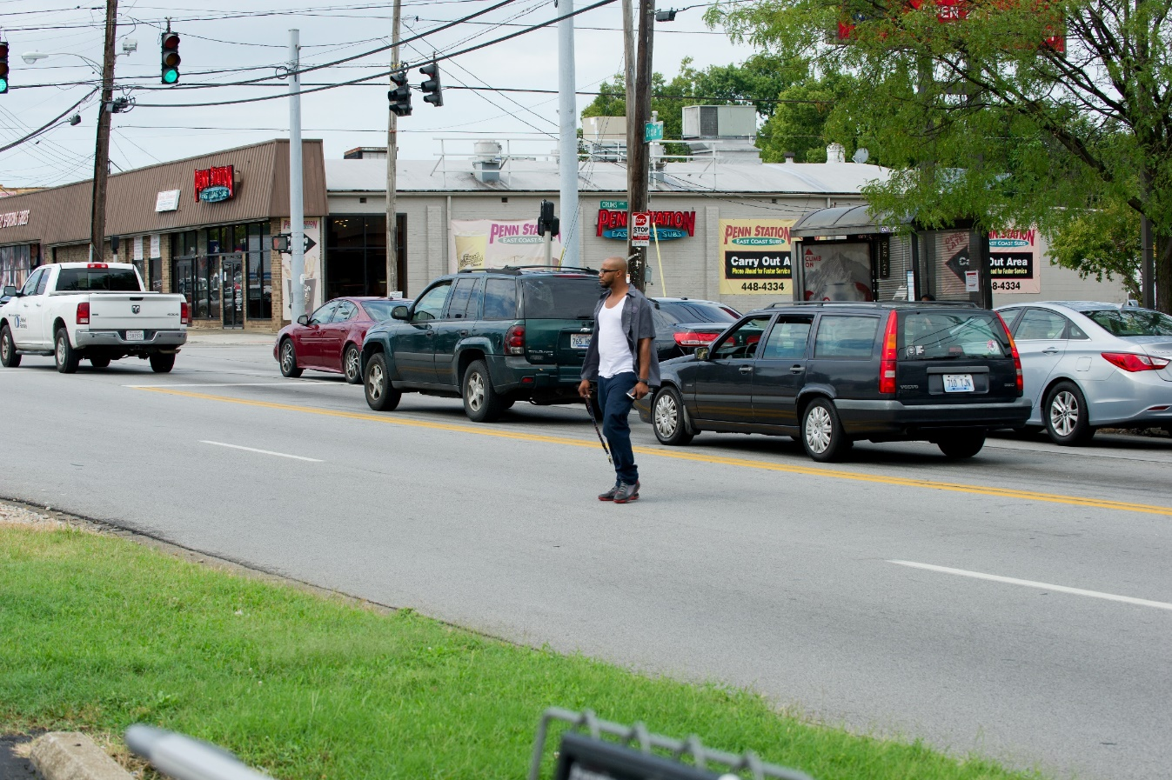
Extreme Challenges
Physical constraints
Public perception
Aggressive timeline
TIGER mandates
Multi-modal
Notes:
Physical constraints of corridor – narrow lanes, no right of way
Public perception – public had fatigue from years of proposals and promises with no results. They had high expectations and low confidence that anything would get done.
Aggressive timeline – an almost unheard-of timeframe to land a project that was supposed to be “shovel-ready”. Someone from FHWA may have said, “Kentucky will not be the first to allow a TIGER project to fail.”
TIGER mandates – not only is the budget strictly allocated, there are requirements for performance after implementation. Basically, we had to design the project and create a way to measure its success … then wait to see if it succeeds.
Multi-modal – we are in the business of moving people, not cars. We thought about the best and most efficient ways to move people, and created that in our project.
Current Conditions High Pedestrian Usage Strong Transit Ridership
Design Considerations First BRT in the region Wider, Safer Sidewalks Improved Crosswalks Transit Signal Priority

Slide 7
Warp-Speed Schedule
November 2015 – TIGER award
June 2016 – Notice to Proceed
June 2017 – Final PS&E
December 2019 – Project completion

Slide 8
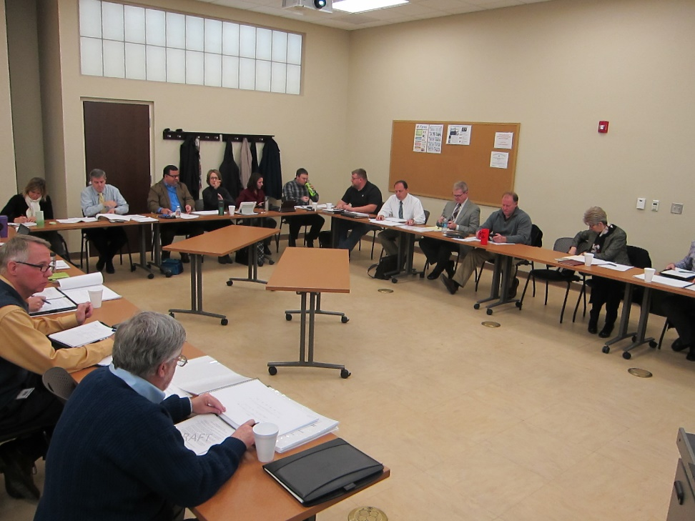
An “Intersectional” Approach
Most projects are separated into “sections” – linear process of work
New Dixie schedule too aggressive for standard process
“Intersection” process – all teams come together to collaborate from beginning of project:
Construction
Traffic management
Client
Notes:
Coordination with KYTC District 5 – Heath Phillips, PE
Regularly scheduled meetings
Applying Lessons Learned from adjoining project activity
General Topics: MOT / Phasing Utilities Constructability
Unique design required early ownership by Construction Staff

Slide 9
High Stakes Decisions, High Impact Results
No Right of Way Phase
Access Management
BRT Route
Landscaping

Slide 10
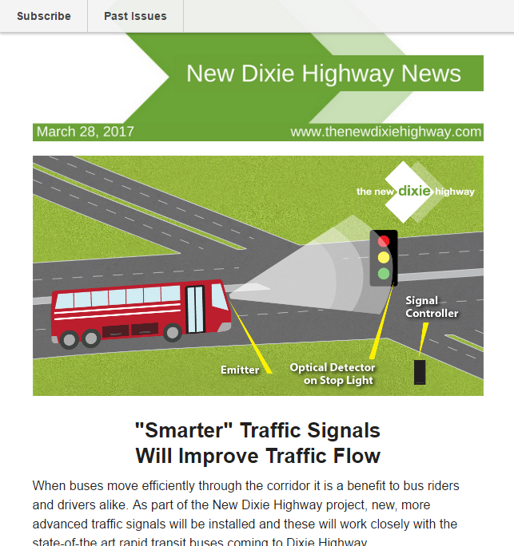
Communication
Advisory Committee
Targeted Business Outreach
Social Media
Branding Surveys
Press Releases
E-newsletters
Website

Slide 11
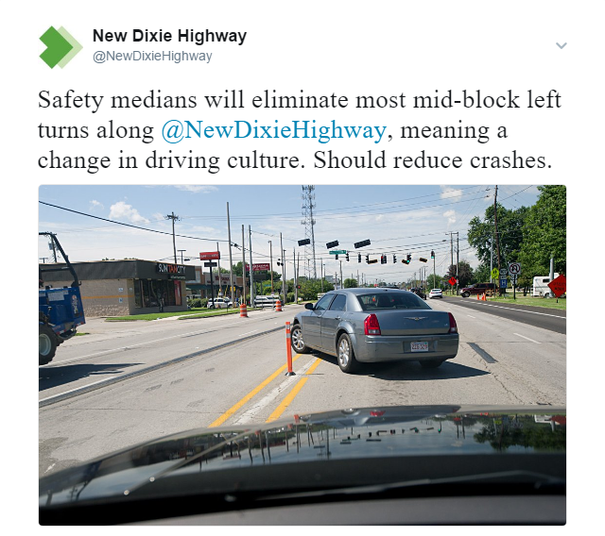
Access Management Policy
Consistent
Few Exceptions
Developed in Context
Communication
To be adopted in Land Development Code

Slide 12
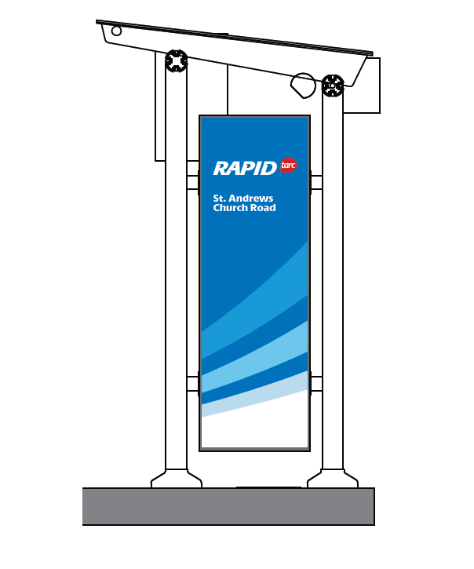
Bus Rapid Transit
Unique stations
Fewer stops
One hour round trip from Gene Snyder to downtown
Ladders of opportunity
Signal pre-emption
Unique brand: RAPID

Slide 13
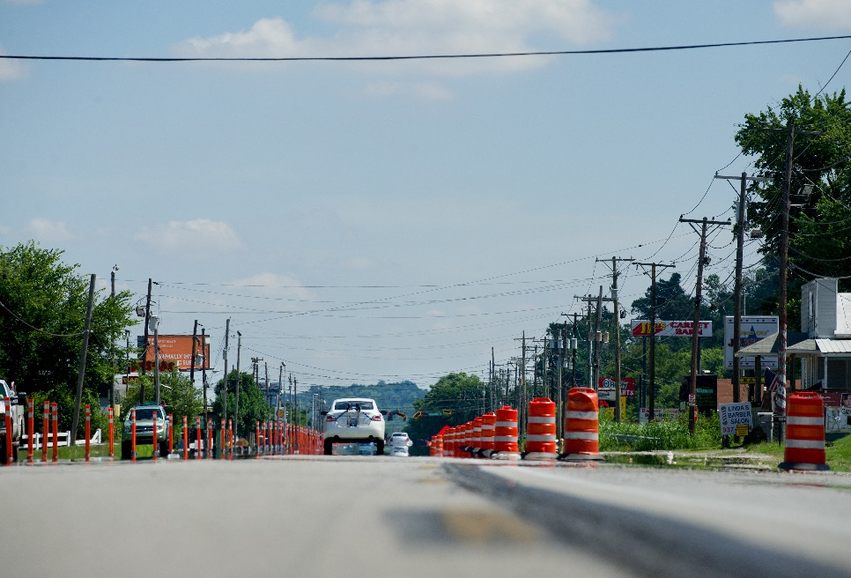
Surprising Paths to Success
Aggressive schedule
“Intersectional” process required cooperation
Robust communication plan
Managed expectations
Engage the end user
Challenge the consultant

